Slide 1
Topic 11 Lecture 11a Memory Management
CSCI 240
Data Structures and Algorithms
Prof. Dominick Atanasio

Slide 2
Dictum
All programmers want an infinite abount of RAM that is as fast as L1 cache and is nonvolatile. Wishfull thinking!

Slide 3
Memory
The concept of a memory hierarchy
a few MBs of very fast, expensive, volatile cache memory
a few GBs of medium-speed, medium-priced, volatile main memory
A few terabytes of slow, cheap, nonvolatile magnetic or solid-state disk storage
It is the job of the operating system to abstract this hierarchy into a useful model and then manage the abstraction.

Slide 4
Memory Manager
The part of the operating system that manages (part of) the memory hierarchy is called the memory manager
keep track of which parts of memory are in use
allocate memory to processes
deallocate it when they are done

Slide 5
A MEMORY ABSTRACTION: ADDRESS SPACES
The Notion of an Address Space
an abstraction for memory
a kind of abstract memory space for programs to live in
Address space is the set of addresses that a process can use to address memory
Notes:
When you think about it, ip offers a set of addresses (address space)

Slide 6
Swapping
If the physical memory of the computer is large enough to hold all the processes, then most schemes will more or less work.
In practice, the total amount of RAM needed by all the processes is often much more than can fit in memory
Modern operating systems have many processes running at any time
Large user applications, like Photoshop, can easily require 500 MB just to start and many gigabytes when processing data

Slide 7
Approaches
Two general approaches to dealing with memory overload
Swapping
bring in each process in its entirety, run it for a while, then putting it back on the disk if memory is full
Virtual memory allows programs to run even when they are only partially in main memory

Slide 8
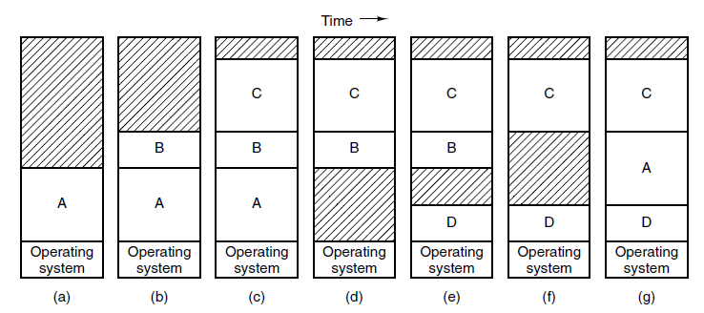
Swapping (1)
Figure 3-4. Memory allocation changes as processes come into memory and leave it. The shaded regions are unused memory
Notes:
Initially, only process A is in memory. Then processes B and C are created or swapped in from disk.
In Fig. 3-4(d) A is swapped out to disk. Then D comes in and B goes out. Finally A comes in again.
Since A is now at a different location, addresses contained in it must be relocated,
either by software when it is swapped in
or (more likely) by hardware during program execution.
base and limit registers would work fine here.

Slide 9
Memory Compaction
Swapping can create multiple holes in memory
It is possible to combine them all into one big one by moving all the processes downward
Requires a lot of CPU time

Slide 10
Fixed vs Dynamic Size
Fixed: the size of a process’ address space never changes, allocation is simple
Dynamic: address space may change to accommodate a process’ needs
If a hole is adjacent to the process, the process can be allowed to grow into the hole otherwise may need to be moved
a good idea is to allocate a little extra memory whenever a process is swapped in or moved
when swapping processes to disk, only the memory actually in use should be swapped
Notes:
If a process cannot grow in memory and the swap area on the disk is full, the process will have to suspended until some space is freed up (or it can be killed).

Slide 11
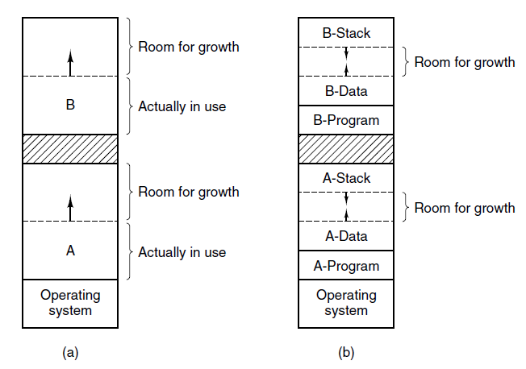
Swapping (2)
Figure 3-5. (a) Allocating space for a growing data segment. (b) Alternative, allocating space for a growing stack and a growing data segment.

Slide 12
Managing Free Memory
When memory is assigned dynamically, the operating system must manage it.
In general terms, there are two ways to keep track of memory usage: bitmaps and free lists

Slide 13
Memory Management with Bitmaps
With a bitmap, memory is divided into allocation units as small as a few words and as large as several kilobytes
Corresponding to each allocation unit is a bit in the bitmap
0 if the unit is free and 1 if it is occupied

Slide 14
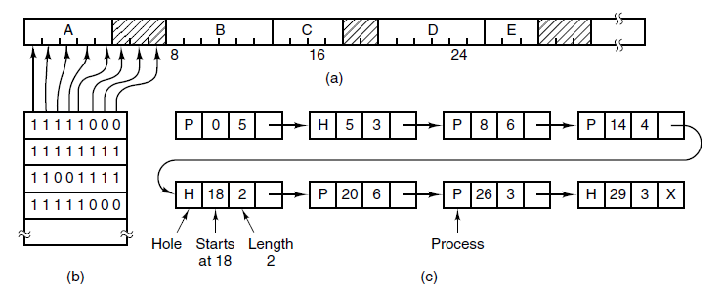
Memory Management with Bitmaps
Figure 3-6. (a) A part of memory with five processes and three holes. The tick-marks show the memory allocation units. The shaded regions (0 in the bitmap) are free. (b) The corresponding bitmap. (c) The same information as a list.

Slide 15
Memory Management with Bitmaps
The size of the allocation unit is an important design issue. The smaller the allocation unit, the larger the bitmap
With an allocation unit as small as 4 bytes, 32 bits of memory will require only 1 bit of the map
the bitmap will take up only 1/32 of memory
With larger allocation unit
Bitmap reduces in size
May be waste memory
Notes:
A memory of 32n bits will use n map bits.
If the allocation unit is arge, the bitmap will be smaller,
appreciable memory may be wasted in the last unit of the process if the process size is not an exact multiple of the allocation unit.

Slide 16
Memory Management with Linked Lists
Maintain a linked list of allocated and free memory segments
a segment either contains a process or is an empty hole between two processes (P or H)
Also contains the address at which it starts, the length, and a pointer to the next item
Segment list might sorted by address
updating the list is straightforward
several algorithms can be used to allocate memory for a created process
Notes:
next fit. It works the same way as first fit, except that it keeps track of where it is whenever it finds a suitable hole. The next time it is called to find a hole, it starts searching the list from the place where it left off last time, instead of always at the beginning, as first fit does.
Best fit searches the entire list, from beginning to end, and takes the smallest hole that is adequate. Rather than breaking up a big hole that might be needed later, best fit tries to find a hole that is close to the actual size needed, to best match the request and the available holes.

Slide 17
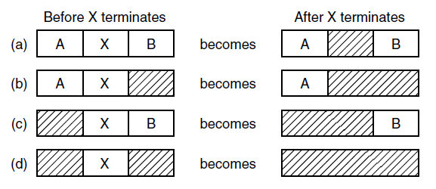
Memory Management with Linked Lists
Figure 3-7. Four neighbor combinations for the terminating process, X.

Slide 18
Memory Management Algorithms
First fit: scan list of segments finds first hole big enough
Next fit: Same but keeps track of last location
Best fit: search the entire list for hole that’s just right
Worst fit: always take the largest available hole
Quick fit: keep lists for common sizes requested
Notes:
next fit. It works the same way as first fit, except that it keeps track of where it is whenever it finds a suitable hole. The next time it is called to find a hole, it starts searching the list from the place where it left off last time, instead of always at the beginning, as first fit does.
Best fit searches the entire list, from beginning to end, and takes the smallest hole that is adequate. Rather than breaking up a big hole that might be needed later, best fit tries to find a hole that is close to the actual size needed, to best match the request and the available holes.
As an example of first fit and best fit, consider Fig. 3-6 again. If a block of size 2 is needed, first fit will allocate the hole at 5, but best fit will allocate the hole at 18.
Best fit is slower than first fit because it must search the entire list every time it is called.
Somewhat surprisingly, it also results in more wasted memory than first fit or next fit because it tends to fill up memory with tiny, useless holes.
First fit generates larger holes on the average.
worst fit, that is, always take the largest available hole, so that the new hole will be big enough to be useful. Simulation has shown that worst fit is not a very good idea either.
a hole list may be kept and sorted on size, to make best fit faster. When best fit searches a list of holes from smallest to largest, as soon as it finds a hole that fits, it knows that the hole is the smallest one that will do the job, hence the best fit.
When the holes are kept on separate lists from the processes, a small optimization is possible. Instead of having a separate set of data structures for maintaining the hole list, as is done in Fig. 3-6(c), the information can be stored in the holes.

Slide 19
Virtual Memory
There is a need to run programs that are too large to fit in memory
Solution adopted in the 1960s, split programs into little pieces, called overlays
Kept on the disk, swapped in and out of memory
Virtual memory : each program has its own address space, broken up into chunks called pages

Slide 20
Virtual Memory
In the 60’s programs that were so large they couldn’t fit in memory
Solution: an overlay system
At program start, an overlay manager was loaded
It immediately started overlay 0
When overlay 0 finished overlay 1 was loaded over 0
Some systems were complex loading multiple overlays to the capacity of RAM
Later called virtual memory

Slide 21
Virtual Memory
Virtual memory is a generalization of the base-and-limit-register
instead of having separate relocation for just the text and data segments, the entire address space can be mapped onto physical memory in fairly small units
works well in a multiprogramming system
many pieces of programs in memory at once
while a program is waiting for pieces of itself to be read in, the CPU can be given to another process

Slide 22
Paging
Most virtual memory systems use a technique called paging
Programs reference a set of memory addresses
E.g. MOV REG,1000
copy the contents of mem address 1000 to REG
program-generated addresses are called virtual addresses and form the virtual address space
MMU (Memory Management Unit) maps the virtual addresses onto the physical memory

Slide 23
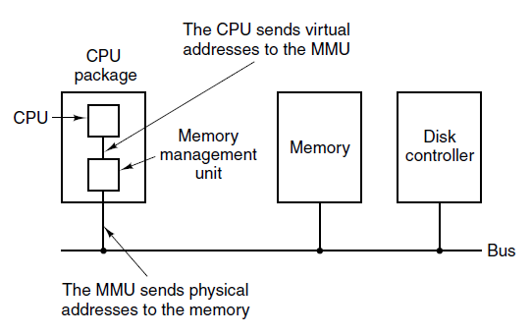
Paging (1)
Figure 3-8. The position and function of the MMU. Here the MMU is shown as being a part of the CPU chip because it commonly is nowadays. However, logically it could be a separate chip and was years ago.

Slide 24
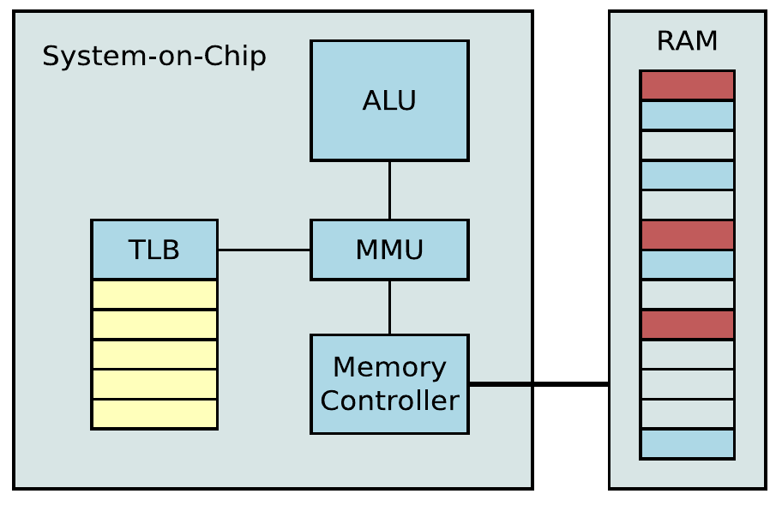
Virtual Memory System (hardware)
Notes:
translation lookaside buffer

Slide 25
Mapping
A very simple example of how this mapping works
Computer that generates 16-bit addresses, from 0 up to 64K − 1
These are the virtual addresses given to each process
Every process sees the same addresses
Assume, however, the computer has only 32 KB of physical RAM
Virtual address space consists of fixed-size units called pages.
The corresponding units in the physical memory are called page frames
Notes:
getconf PAGESIZE

Slide 26
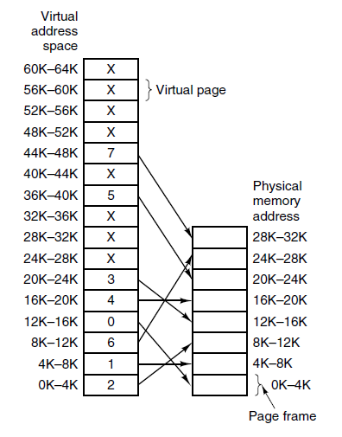
Paging (2)
Figure 3-9. The relation between virtual addresses and physical memory addresses is given by the page table. Every page begins on a multiple of 4096 and ends 4095 addresses higher, so 4K–8K really means 4096–8191 and 8K to 12K means 8192–12287
Notes:
getconf PAGESIZE

Slide 27
Page Faults
What happens if the program references an unmapped address (e.g. MOV $5, 32780)?
Byte 12 within virtual page 8 (starting at 32768)
MMU determines that the page is unmapped
This causes the CPU to trap to the operating system (Page Fault)
The OS chooses a page frame to use, if it’s contents are Dirty, the OS first writes it to disk then loads the requested page from the disk to that frame
The OS updates the map, and restarts the trapped instruction

Slide 28
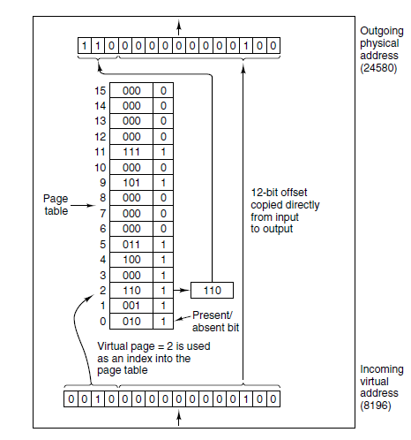
Paging (3)
Figure 3-10. The internal operation of the MMU with 16 4-KB pages.

Slide 29
Page Table Entry (PTE)
The layout of an entry in the page table is highly machine dependent
Page frame number is a fixed size and sets the limit of how much RAM a machine can have
Present/absent bit. If set to 1, the entry is valid and can be used
The Protection bit(s) tell what kinds of access are permitted
Simple scheme (1 bit): 0 = read/write, 1 = read only
Better (3 bits): read, write, execute
Referenced bit is set whenever a page is referenced, used by OS to choose a page to evict when a page fault occurs
Modified: (dirty) used to tell if the page has been changed since loading
Caching: important for pages that map onto device registers. This bit turns on/off caching of the word from device

Slide 30
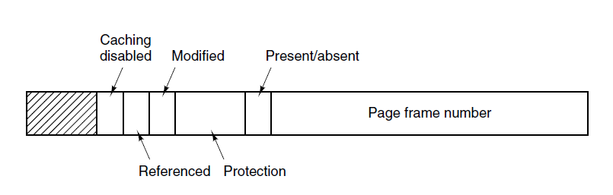
Structure of a Page Table Entry
Figure 3-11. A typical page table entry.

Slide 31
What About the Disk Addresses?
Note that the disk address used to hold the page when it is not in memory is not part of the page table.
The page table holds only that information the hardware needs to translate a virtual address to a physical address
The location of the pages on disk is information that only the OS need to track; this information, and how it is organized, is OS dependent

Slide 32
Speeding Up Paging
Major issues faced:
The mapping from virtual address to physical address must be fast.
Virtual-to-physical mapping must be done on every memory reference
Instructions live in memory too which sometimes causes multiple lookups per instruction. If an instruction execution takes 1 nsec, the page table lookup must be done a fraction nsec to avoid a major bottleneck
If the virtual address space is large, the page table will be large.
32-bit address space has 1 million pages. 64-bit address space? Let’s not go there
Page table must have 1 million entries. And remember that each process needs its own page table
Notes:
32-bit virtual address space (2^32 addresses or 4GB of virtual address space)
and 4kB page-size means there are 2^20 entries in the page table.

Slide 33
Approaches
An array of fast hardware registers, with one entry for each virtual page, indexed by virtual page number
When a process starts, the OS loads the registers with the process’ page table, taken from main memory
Very expensive
having to load the full page table at every context switch would destroy performance
Translation Lookaside Buffer (associative cache)
The page table is in memory
Most programs tend to make a large number of references to a small number of pages; only a small fraction of the page table entries are heavily read
It is usually inside the MMU and consists of a small number of page table entries
fields have a one-to-one correspondence with the fields in the page table

Slide 34
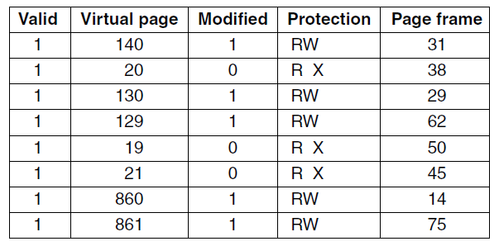
Translation Lookaside Buffers
Figure 3-12. A TLB to speed up paging.
Valid bit is used to indicate if the entry is in use or not.

Slide 35
TLB in Action
A virtual address is presented to the MMU for translation
hardware checks to see if its virtual page number is present in the TLB by comparing it to all the entries
This is done in parallel , simultaneously
If a valid match is found and the access does not violate the protection bits, the page frame # is taken directly from the TLB
the instruction is trying to write on a read-only page, a protection fault is generated
If the virtual page number is not in the TLB
MMU detects the miss and does an ordinary page table lookup
It evicts one of the entries from the TLB and replaces it with the new lookup
When the entry is evicted from the TLB, the modified bit is copied back into the page table entry in memory
if that page is used again soon, the second time it will result in a TLB hit rather than a miss

Slide 36
Software TLB Management
In most designs, TLB management and handling TLB faults are done entirely by the MMU hardware
However, many RISC machines, including the SPARC, MIPS, do nearly all of this page management in software
When a TLB miss occurs, instead of the MMU doing a lookup in page tables to find reference, it generates a TLB fault and hands-off the problem to the operating system
The OS must find the page, overwrite an entry in the TLB with the new one, then restart the faulted instruction
if the TLB is moderately large, software management can be acceptably efficient
OS management could lead to smarter decisions on TLB entry replacement
A soft miss occurs when the page referenced is not in the TLB
A hard miss occurs when the page itself is not in the page table
At least a million times slower than a soft miss

Slide 37
Types of Misses
Some misses are softer or harder than others
Three possibilities:
minor page fault: the page may actually be in memory, but not in this process’ page table
Brought in by another process; just need map the page appropriately in the page tables.
major page fault: the page needs to be brought in from disk
segmentation fault: the program accessed an invalid address. the OS usually kills the program

Slide 38
Multilevel Page Tables
TLBs can be used to speed up virtual-to-physical address translation over the original page-table-in-memory scheme
How to deal with very large virtual address spaces?
The multilevel page table method avoids keeping all the page tables in memory all the time
Example: Suppose a process needs 12 megabytes: the bottom 4 MB of memory for program text, the next 4 MB for data, and the top 4 MB for the stack. In between the top of the data and the bottom of the stack is a gigantic hole that is not used.

Slide 39
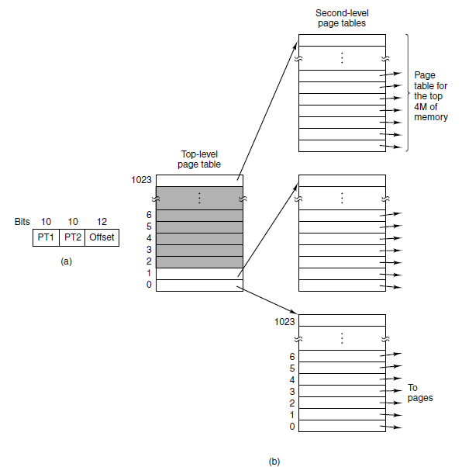
Multilevel Page Tables
Figure 3-13. (a) A 32-bit address with two page table fields. (b) Two-level page tables.

Slide 40
Page Replacement Algorithms
When a page fault occurs, the operating system has to choose a page to evict (remove from memory) to make room for the incoming page
If the page to be removed has been modified while in memory, it must be rewritten to the disk,
The page to be read in just overwrites the page being evicted
The OS could choose a random page to evict at each page fault, system performance is much better if a page that is not heavily used is chosen
The problem of ‘‘page replacement’’ occurs in other areas of computer design as well
most computers have one or more memory caches consisting of recently used memory blocks
Web servers keep a certain number of heavily used Web pages in a cache

Slide 41
Page Replacement Algorithms
Optimal algorithm
Not recently used algorithm
First-in, first-out (FIFO) algorithm
Second-chance algorithm
Clock algorithm
Least recently used (LRU) algorithm

Slide 42
Optimal Page Replacement Algorithm
Easy to describe but impossible to implement
The page with the highest label should be removed
The moment that a page fault occurs with some set of pages is in memory
One of these pages will be referenced on the very next instruction
Other pages may not be referenced until 10, 100, or perhaps 1000 instructions later
This algorithm is unrealizable
the OS has no way of knowing when the pages will be referenced
Similar problem as the shortest-job-first scheduling algorithm

Slide 43
Not Recently Used (NRU) Algorithm
At page fault, system inspects pages
Categories of pages based on the current values of their R and D bits:
Hardware sets these bits but the OS clears them
Class 0: not referenced, not modified.
Class 1: not referenced, modified.
Class 2: referenced, not modified.
Class 3: referenced, modified.
NRU algorithm removes a page at random from the lowest-numbered non-empty class

Slide 44
First-In, First-Out (FIFO) Algorithm
A linked list (circular works) is maintained of all pages in memory
The head of the list is the oldest (think queue)
When a page fault occurs , the oldest page is discarded and the new page reference is added to the tail of the list
An old page that is used heavily might be evicted just because it’s been in memory a long time
In its purest form, this algorithm is not used much
The second chance algorithm is a modification of FIFO

Slide 45
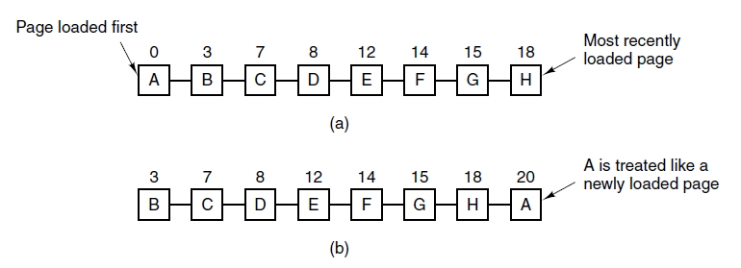
Second-Chance Algorithm
Figure 3-15. Operation of second chance. (a) Pages sorted in FIFO order. (b) Page list if a page fault occurs at time 20 and A has its R bit set. The numbers above the pages are their load times.
Reasonable but inefficient because of its constant maintenance of the list

Slide 46
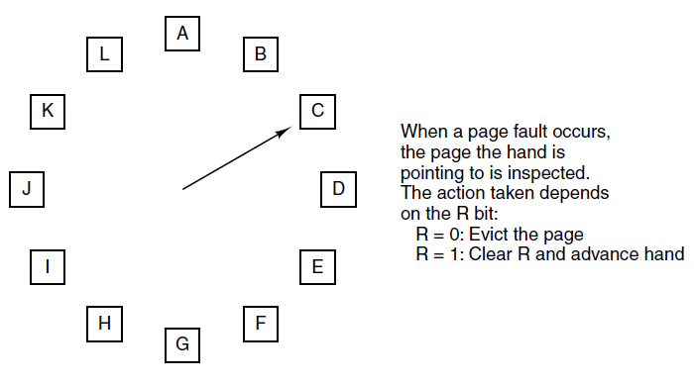
Clock Page Replacement Algorithm
Figure 3-16. The clock page replacement algorithm.

Slide 47
Least Recently Used (LRU)
A good approximation to the optimal algorithm
based on page usage in the last few instructions
Those heavily used will probably be used again
idea suggests a realizable algorithm
when a page fault occurs, evict the page that has been unused for the longest time
Not cheap to implement
To fully implement, a linked list of all pages in memory must be maintained with most recently used page at the front and the least recently used page at the rear

Slide 48
LRU with Special Hardware
Equip the hardware with a 64-bit counter
Automatically increment after each instruction
Add a field to the page table for this counter (again 64b)
After each memory reference, this field is updated with the current count in the entry that was referenced
When a page fault occurs, scan the table for the entry with the lowest count
Few, if any, machines have the required hardware to implement this system
It will also make the page table much larger

Slide 49
LRU with Software
NFU (Not Frequently Used) (not to be confused with the NRU)
A software counter associated with each page
At each clock interrupt, the operating system scans all the pages in memory, For each page, the R bit is added to the counter
counters roughly keep track of how often each page has been referenced
At a page fault, the page with the lowest counter is evicted
Main problem, with NFU never forgets anything
A small modification:
the counters are each shifted right 1 bit before the R bit is added
the R bit is added to the leftmost rather than the rightmost bit
known as aging

Slide 50
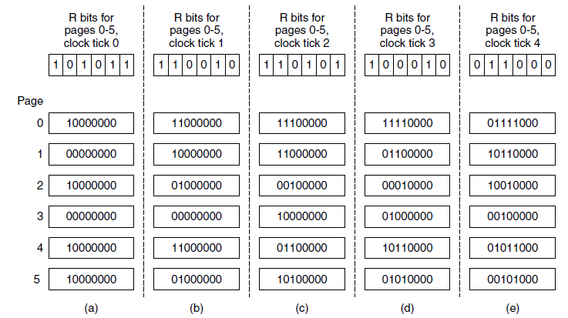
Simulating LRU in Software
Figure 3-17. The aging algorithm simulates LRU in software. Shown are six pages for five clock ticks. The five clock ticks are represented by (a) to (e).

Slide 51
LRU with Software (NFU)
This algorithm differs from LRU in two important ways
Consider pages 3 and 5 in previous figure, neither has been referenced in two time periods; both were referenced the period prior, on a page fault one of those two should be evicted The problem, we don’t know which one was most recently accessed between tick 1 and tick 2
We’ve lost our earlier memory because of the bit shifting. There must be a limited number of bits devoted to this process In practice, however, 8 bits is generally enough if a clock tick is around 20 msec, if a page has not been referenced in 160 msec, it probably is not that important

